Slide 1

Understanding
Histograms

Slide 2
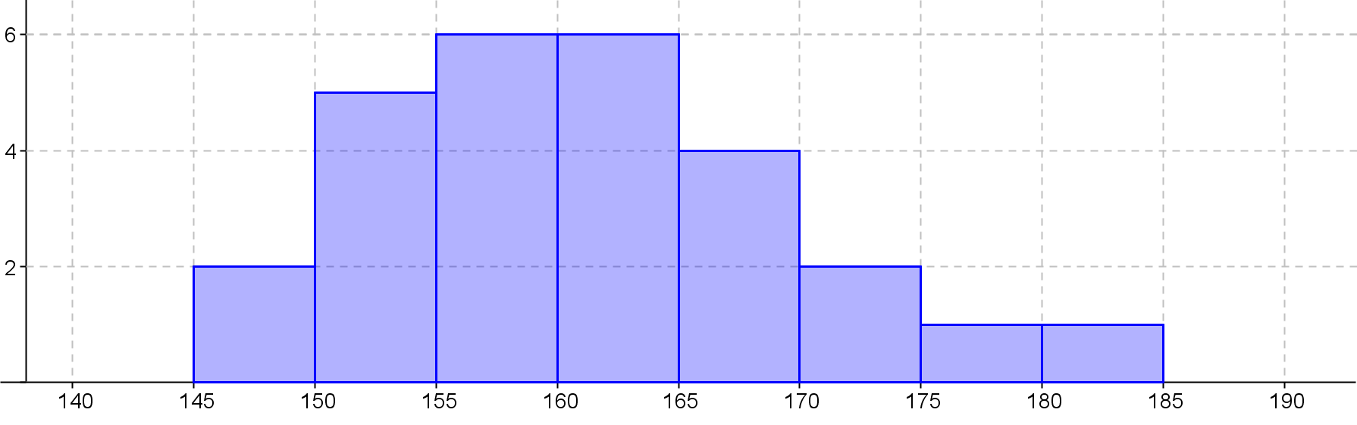
24
7
30
Date
Histograms
EQ – What steps do I follow to create a histogram?
Heights of students in 8-7
Title
We drew this last
lesson!
Frequency
No Gaps between the columns
Height (cm)
Labels
Scale
How the data looks in a histogram is important and can be described in main ways
Notes:
iler

Slide 3
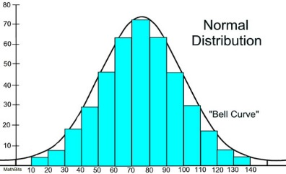
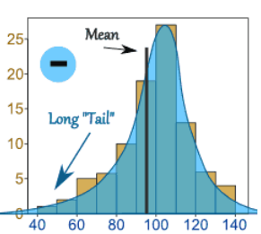
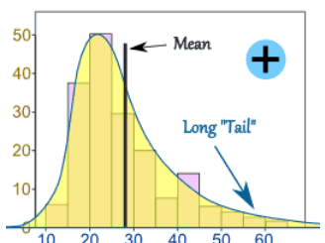
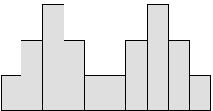
24
7
30
Date
Topic - Data
EQ – How do we describe data distribution.
Normal Distribution – Not skewed
A Normal Distribution is not skewed.
It is perfectly symmetrical and the Mean, mode and median are all exactly at the peak.
Negative Skew
The long "tail" is on the negative or left side
the peak. The mean is also on the left of the peak. The Median is closer to the peak and the mode is at the peak.
Positive Skew
The long tail is on the positive or right
side of the peak. The mean is also on the right of the peak value. The median will be close to the peak and the mode is at the peak
Bimodal
Bimodal means it has 2 modes.
On a graph it has 2 peaks which are its 2 modal values.
Notes:
Go through with class piece by piece

Slide 4
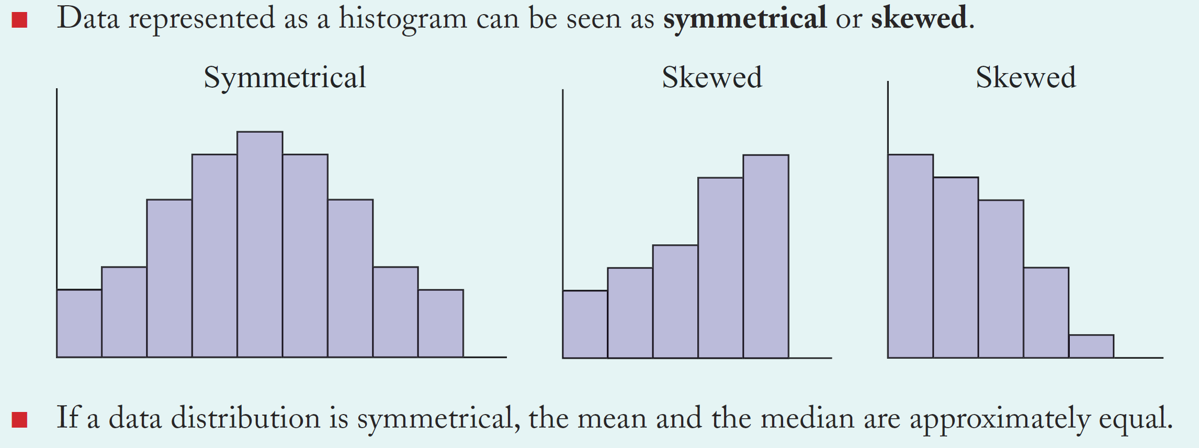
24
7
30
Analysing Data with histograms
Date
EQ – How do we analyse data from histograms?
How do we analyse a graph?

Slide 5
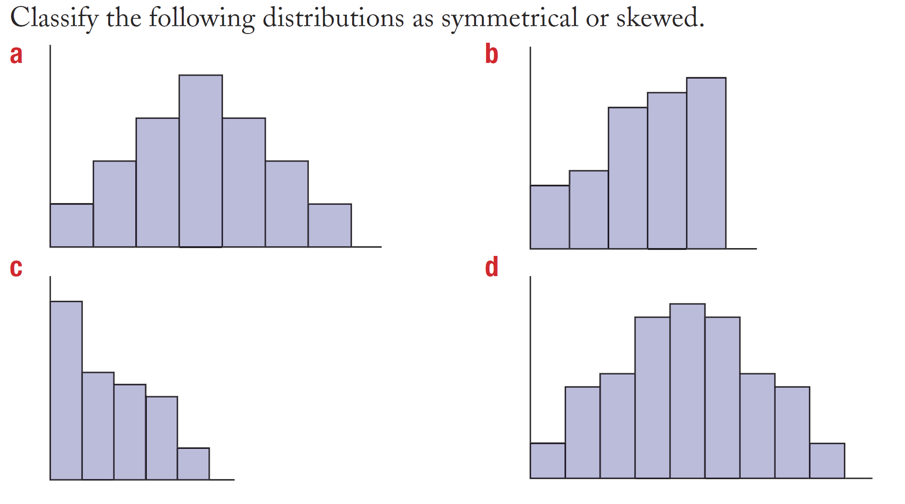
Practice

Slide 6
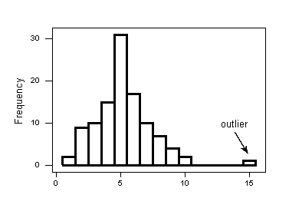
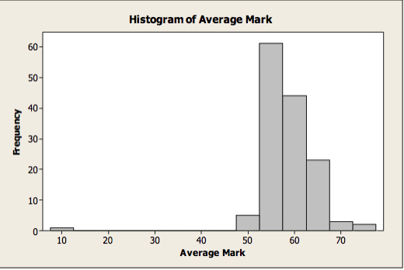
Histograms with outliers
How do we spot outliers?
One bar will be very far away

Slide 7
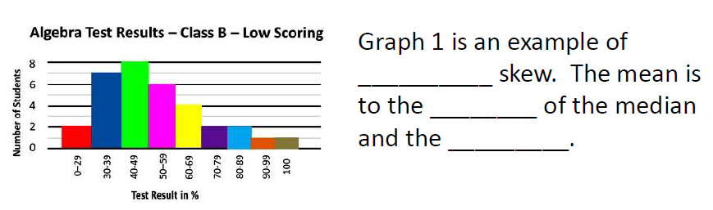
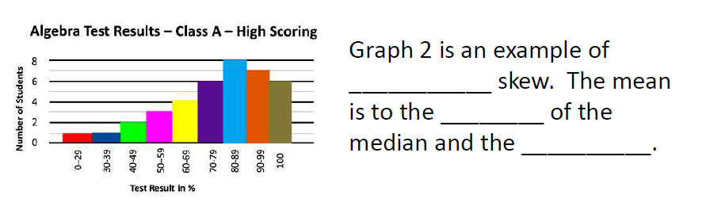
positive
right
mode
negative
left
mode

Slide 8
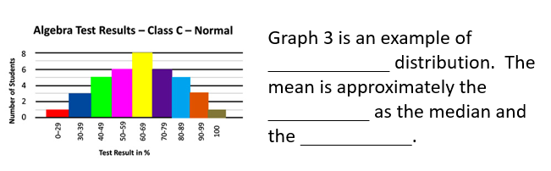
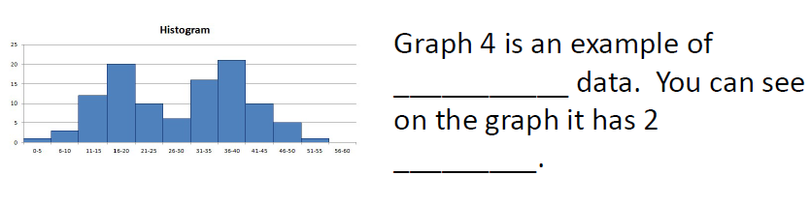
symmetrical
same
mode
bimodal
modes

Slide 9
Extension Questions

Slide 10
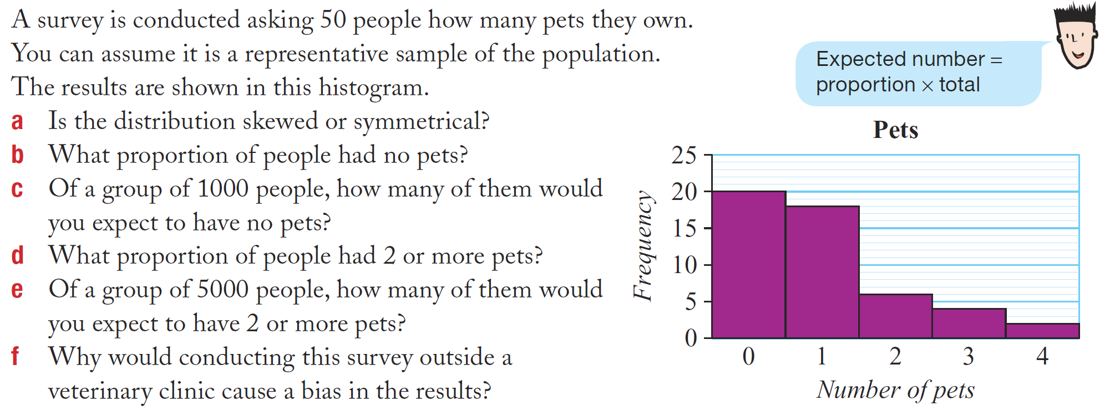
Task

Slide 11
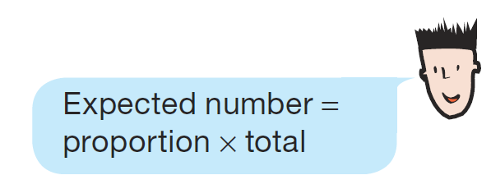
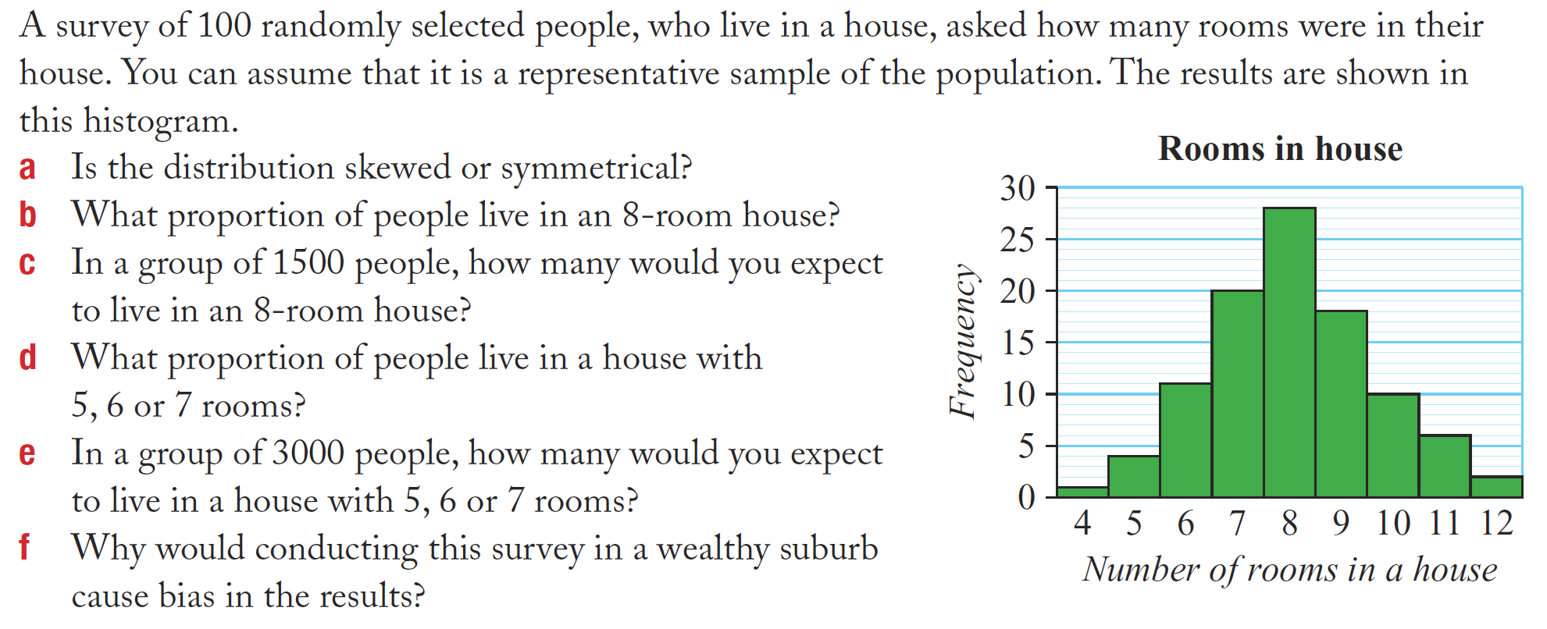
Task

Slide 12
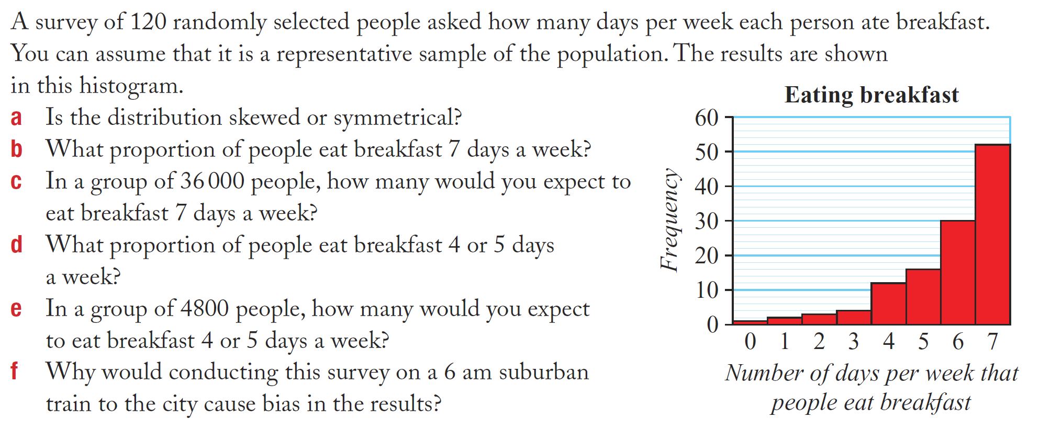
Task

